Slide 1
The definite article = the
In French, there are four different words that mean “the”.

Slide 2

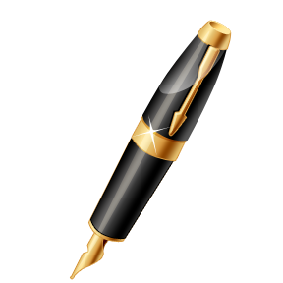

le
Introduces masculine/singular nouns
le livre
le stylo
le drapeau

Slide 3
la
Introduces feminine/singular nouns
la table
la porte
la chaise

Slide 4
les
Introduces all plural nouns
les crayons
les livres

Slide 5

L’
Introduces nouns that start with a vowel or h
l’élève
l’hôtel
l’ordinateur

Slide 6
To discuss things that you like and things that you don’t like, you will need the definite article.
I like music.
J’aime la musique.

Slide 7

I really like chocolate.
J’aime bien le chocolat.
I hate math.
Je déteste les maths.
I don’t like school.
Je n’aime pas l’école.

Slide 8
I like ice cream
J’aime la glace.
I prefer French.
Je préfère le français.

